Slide 1
Bionic filtering
Viviana Elizabeth Dueñas Chávez
A01704446

Slide 2
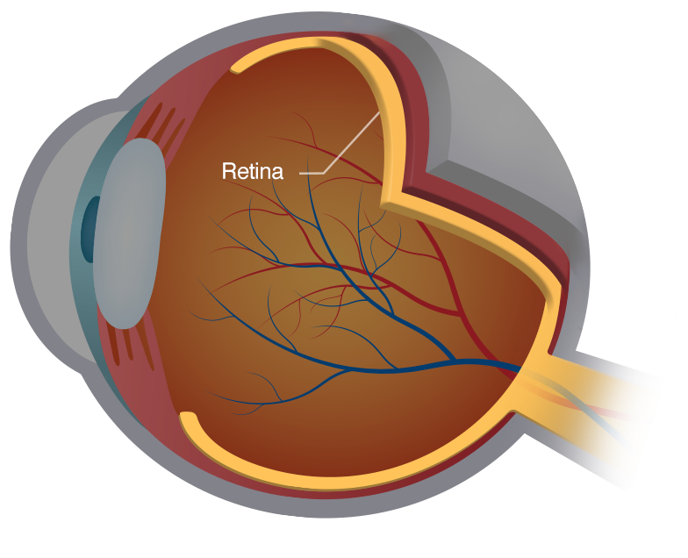
Blindness in the world
Retina damages:
Most common of childhood blindness.
Middle and most wealthy.

Slide 3
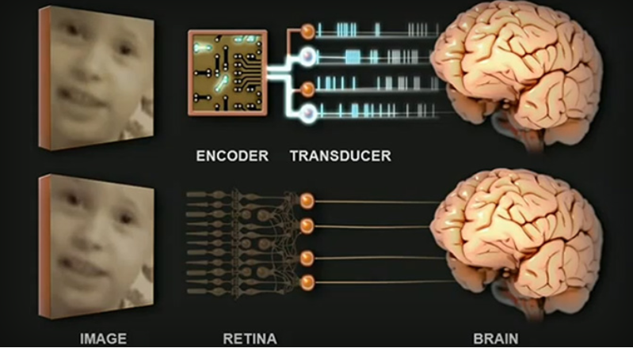
Retina:
Light processing for visual recognition.

Slide 4
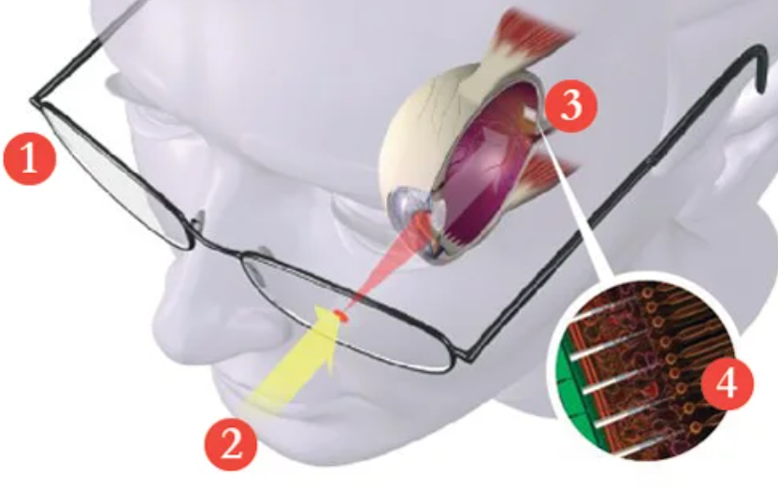
Bionic eye:
Artificial photoreceptor cells.
576-pixel range, grayscale.

Slide 5
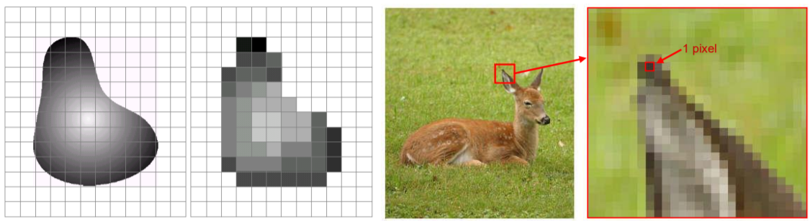
Digital image
Grayscale 1 sample per point
In memory, shade or color info

Slide 6
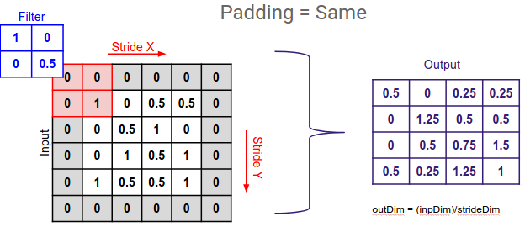
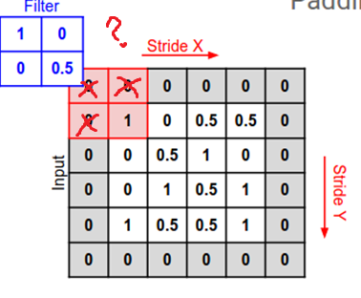
Kernel convolution
Application of filters.
Kernel as a weighted average.
Padding to original image.

Slide 7
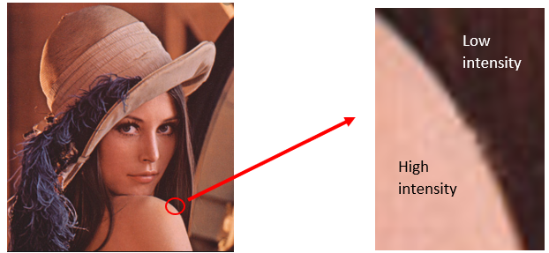
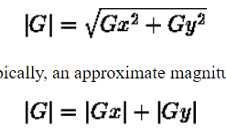
Edge detection
Identify sharpe changes of intensities.
2 gradients:
X- vertical
Y- horizontal
No changes, opposite signs turn 0.
|G| - Magnitud

Slide 8
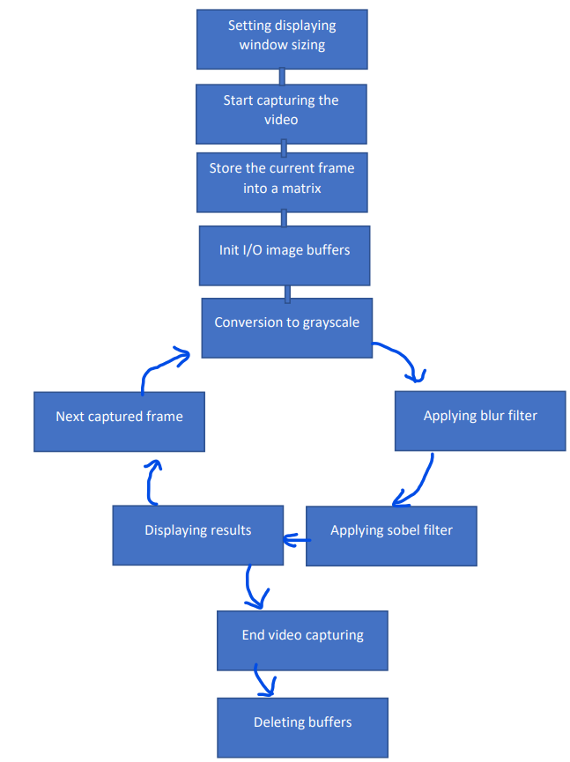
Solution- Flow of program
Capture.set() 640x480
VideoCapture(0)
Mat class, n-dim array
(single channel 8 bits- grayscale)
Mat instance per result.
RGB2GRAY- 0.299/0.587/0.114
boxFilter_host/device() 3x3 kernel- 1s
sobelFilter_host/device() 3x3 – 2 kernels
cvshowImage() display Mat
ESC- exit window
Deleting memory allocated

Slide 9
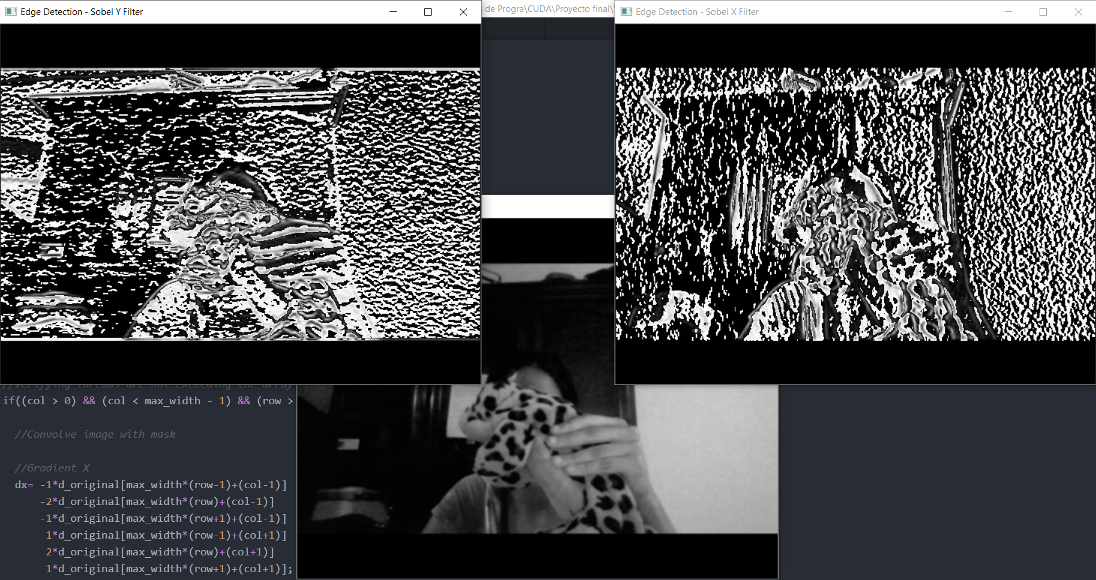
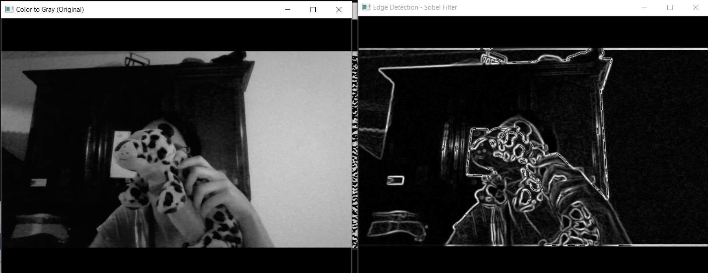
Filtering results

Slide 10
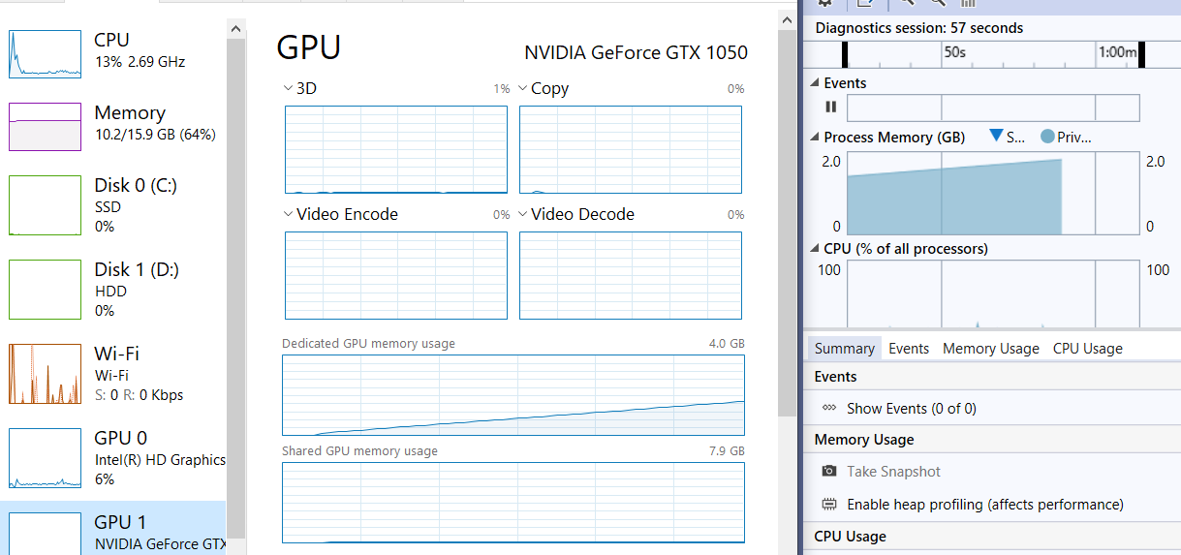
Results
A lot of calculations for low performance

Slide 11
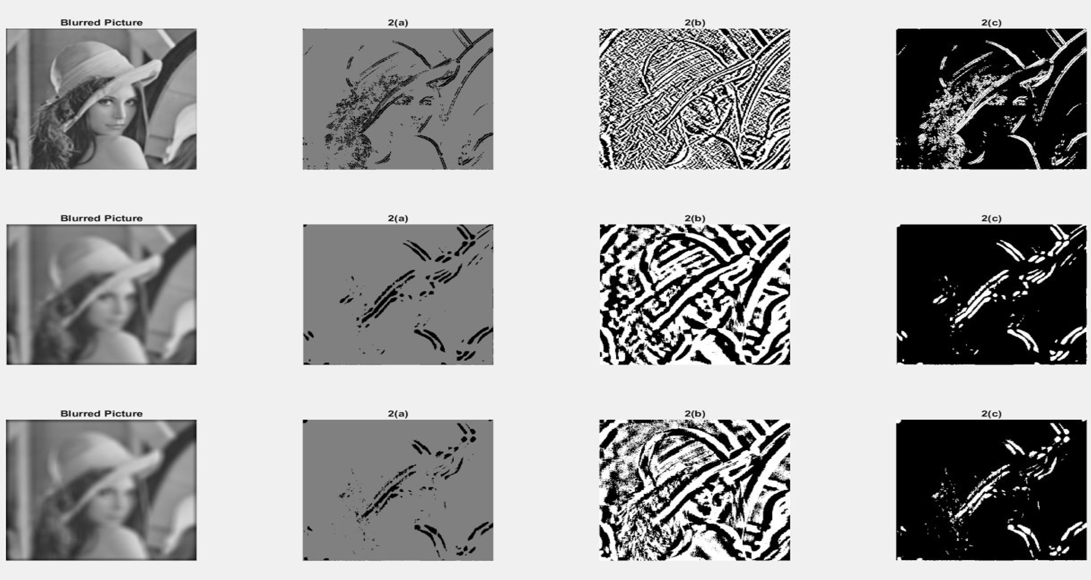
Observations
Further filters for specific purposes or personalized.
Computer vision +
high throughput +
grayscale higher resolutions
= Improving artificial sight

